Slide 1
The Will to Lead: Creating Healthy School Cultures
Anthony Muhammad, PhD

Slide 2
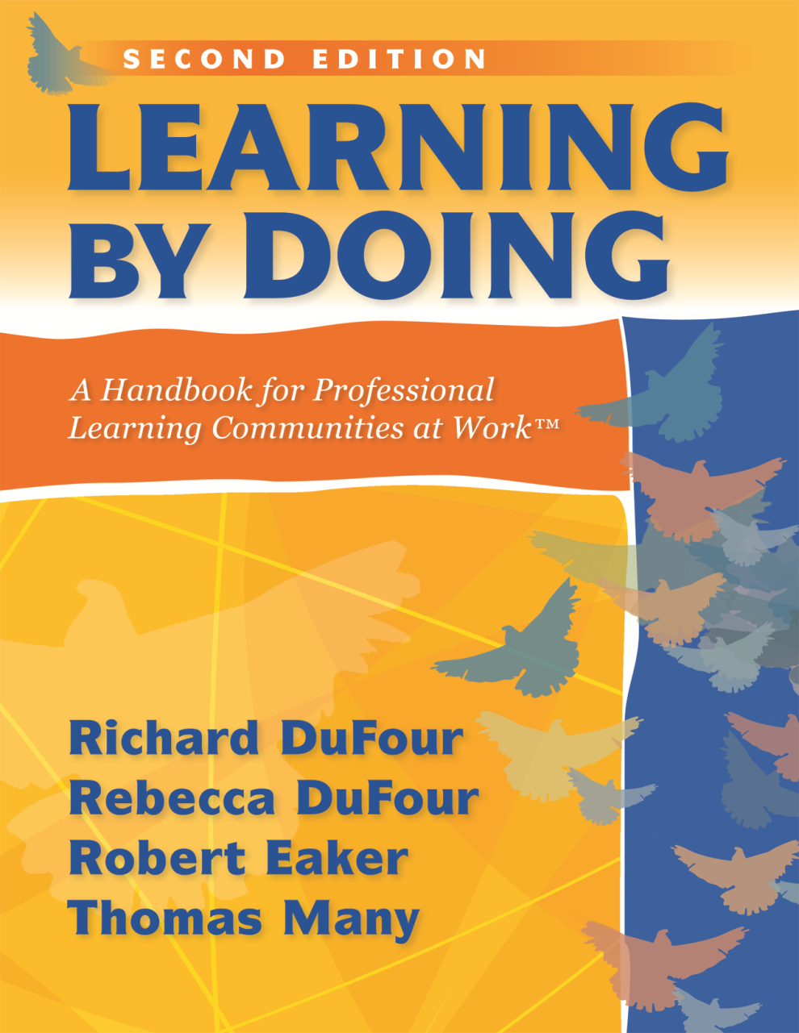
Call to Arms
“When a school or district functions as a PLC, educators within the organization embrace high levels of learning for ALL students
as both the reason the organization exists and the fundamental responsibility of those who work within it.”
—DuFour, DuFour, Eaker, & Many, Learning by Doing:
A Handbook for Professional Learning Communities at Work (2010)

Slide 3
A Major Shift in Paradigm
Invitation
Guarantee

Slide 4
What Has History Taught Us?
All students have not benefited equally from their access to publically funded schools.

Slide 5
What’s Next? Is Change Necessary?
“Insanity is doing the same thing over and over
and expecting a different result.”
—Albert Einstein

Slide 6
Two Forms of Change
Technical–structural (skill)
Cultural (will)

Slide 7
Will and Skill
Culture
(Learning Environment)
Skill
(Learning Activities)

Slide 8
High Will and High Skill
High Will
and
Low Skill
High Will
and
High Skill
Low Skill
and
Low Will
High Skill
and
Low Will

Slide 9
Technical vs. Cultural
Both forms of change are essential to improving organizations.
Schools tend to focus heavily on technical changes and spend little time on cultural change.
Deep change cannot be accomplished without cultural change.

Slide 10
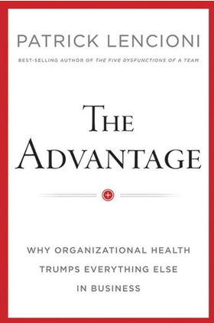
Don’t Underestimate Culture
“The health of an organization provides the context for strategy, finance, marketing, and everything else that happens within it, which is why it is the single greatest factor determining an organization’s success. More than talent. More than knowledge. More than innovation.”
—Lencioni, The Advantage: Why Organizational
Health Trumps Everything Else in Business (2012), p. 2

Slide 11
Choosing Being “Smart” Over Being “Healthy”
Smart
Healthy
The “sophistication bias”
The “adrenaline bias”
The “quantification bias”
Build a cohesive team.
Creating clarity.
Reinforcing clarity
—Lencioni, The Advantage: Why OrganizationalHealth Trumps Everything Else in Business (2012)

Slide 12
Avoiding Culture
“Most leaders prefer to look for answers where the light is better, where they are more comfortable. And the light is certainly better
in the measurable, objective, and data-driven world of organizational intelligence (the smart side of the equation) than in the messier, more unpredictable world of organizational health.”
—Lencioni, The Advantage: Why Organizational
Health Trumps Everything Else in Business (2012), p. 7

Slide 13
School Culture
“School culture is the set of norms, values, and beliefs, rituals and ceremonies, symbols and stories that make up the ‘persona’ of the school.”
—Peterson, “Is Your School Culture Toxic or Positive?”
Education World (2002)

Slide 14
Complexity of Cultural Change
Anthropology
Sociology
Psychology
Political Science
History
Economics

Slide 15
“Healthy” School Culture
“Educators have an unwavering belief in the ability of all of their students to achieve success, and they pass that belief on to others in overt and covert ways. Educators create policies and procedures and adopt practices that support their belief in the ability of every student.”
—Peterson, “Is Your School Culture Toxic or Positive?”
Education World (2002)

Slide 16
Healthy School Culture Connection of Two Great Concepts
Student- Centered Learning Environment
Student- Centered Learning Activities
Learning for ALL Students

Slide 17
Learning Activities?
An analysis of research conducted over a 35-year period demonstrates that schools that are highly effective produce results that almost entirely overcome the effects of student backgrounds.
(Marzano, What Works in Schools, 2003)

Slide 18
The Problem
We know what to do; the problem is convincing educators to embrace and use these strategies.

Slide 19
The Task at Hand
“If schools are to be transformed into learning communities, educators must be prepared first of all to acknowledge that the traditional guiding model of education is no longer relevant in a post-industrial, knowledge-based society. Second, they must embrace ideas and assumptions that are radically different than those that have guided schools in the past.”
—DuFour & Eaker, Professional Learning Communities
at Work (1998), p. 34

Slide 20
The Transformational Leader
“Schools need transformational leaders at every level. These leaders are determined to lead people to better behavior. They do not stop at criticizing current behavior. Rather, they use their resources and influence to help people improve.”
—Muhammad & Hollie, The Will to Lead, The Skill to Teach:
Transforming Schools at Every Level (2011)

Slide 21
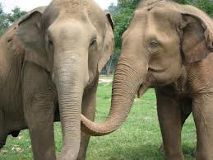
Are You Willing to Confront the Elephants in the Room?

Slide 22
Predeterminations
Perceptual
Intrinsic
Institutional

Slide 23
Perceptual Predetermination
“Perceptual predetermination involves an educator’s own socialization and the impact
of that socialization on his or her practice in the classroom, including expectations for student performance.”
—Muhammad, Transforming School Culture: How to Overcome Staff Division (2009), p. 21

Slide 24
Stereotypes
“To help simplify a complex world, people develop mental models called schemas. Problems arise when people start to oversimplify schemas. Oversimplified schemas are known as stereotypes. Stereotypes are fixed impressions and exaggerated and preconceived ideas and descriptions about a certain type of person, group, or society.”
—Langlois, Kalakanis, Rubenstein, Larson, Hallam, & Smoot,
“Maxims or Myths of Beauty? A Meta-Analytic and Theoretical Review,” Psychological Bulletin (2000), p. 390

Slide 25
Crucial Conversations
Conflicting opinions
Potential to become highly emotional
Stakes are high
Patterson, et.al, Crucial Conversations: Tools for
Talking When the Stakes are High (2011)

Slide 26
Corrective Lenses “The Optometrist”
Combat false/incomplete information with better information.
Try:
Enlightenment
Encouragement
Experimentation

Slide 27
Intrinsic Predetermination
“Intrinsic predetermination is the student’s perception of his or her probability of success in school. The messages that students receive from their environment—the home, community, and school—can either build their confidence or work to destroy it.”
—Muhammad, Transforming School Culture:
How to Overcome Staff Division (2009), p. 23

Slide 28
When Cultures Collide
Student Norms
School Norms

Slide 29
Assimilation or Education
Assimilation
Education
Control
Manipulation
Standardization
Docile
Liberation
Development
Creativity
Empowerment

Slide 30
Gifted and Talented Education
“Gifted and talented education works for two reasons: the student believes that he is gifted and the teacher believes that he is gifted. Based on this agreement, the teacher and student create the right learning environment and they utilize rigorous learning activities. All human beings possess a gift; the key is to identify and capitalize on it.”
—Renzulli, “What Makes Giftedness? Reexamining a Definition,”
Phi Beta Kappan (1978)

Slide 31
Pedagogy of Confidence
Identify and activate student strengths.
Elicit high intellectual performance.
Provide enrichment.
Integrate prerequisites.

Slide 32
The Maestro
Blending the best in students with the best in the institution to create beautiful music

Slide 33
Institutional Predetermination
“I contend that we have institutional barriers in place that make the job of educating every student very difficult.”
—Muhammad, Transforming School Culture:
How to Overcome Staff Division (2009), p. 25

Slide 34
Policy Elephants
Student grading policies
Student placement in advanced coursework
Zoning policies around ethnicity and economic class
Discipline/expulsion policies
Graduation standards/policies

Slide 35
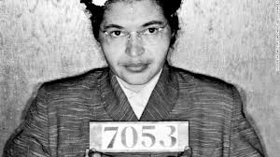
Rosa Parks Moment

Slide 36
It’s Not About Us! It’s About Them!

Slide 37
Contact Information
Website:
www.newfrontier21.com
E-mail:
amuhammad@newfrontier21.com
Follow on Twitter:
@newfrontier21
Like on Facebook:
Keyword -Dr. Anthony Muhammad

